Slide 1
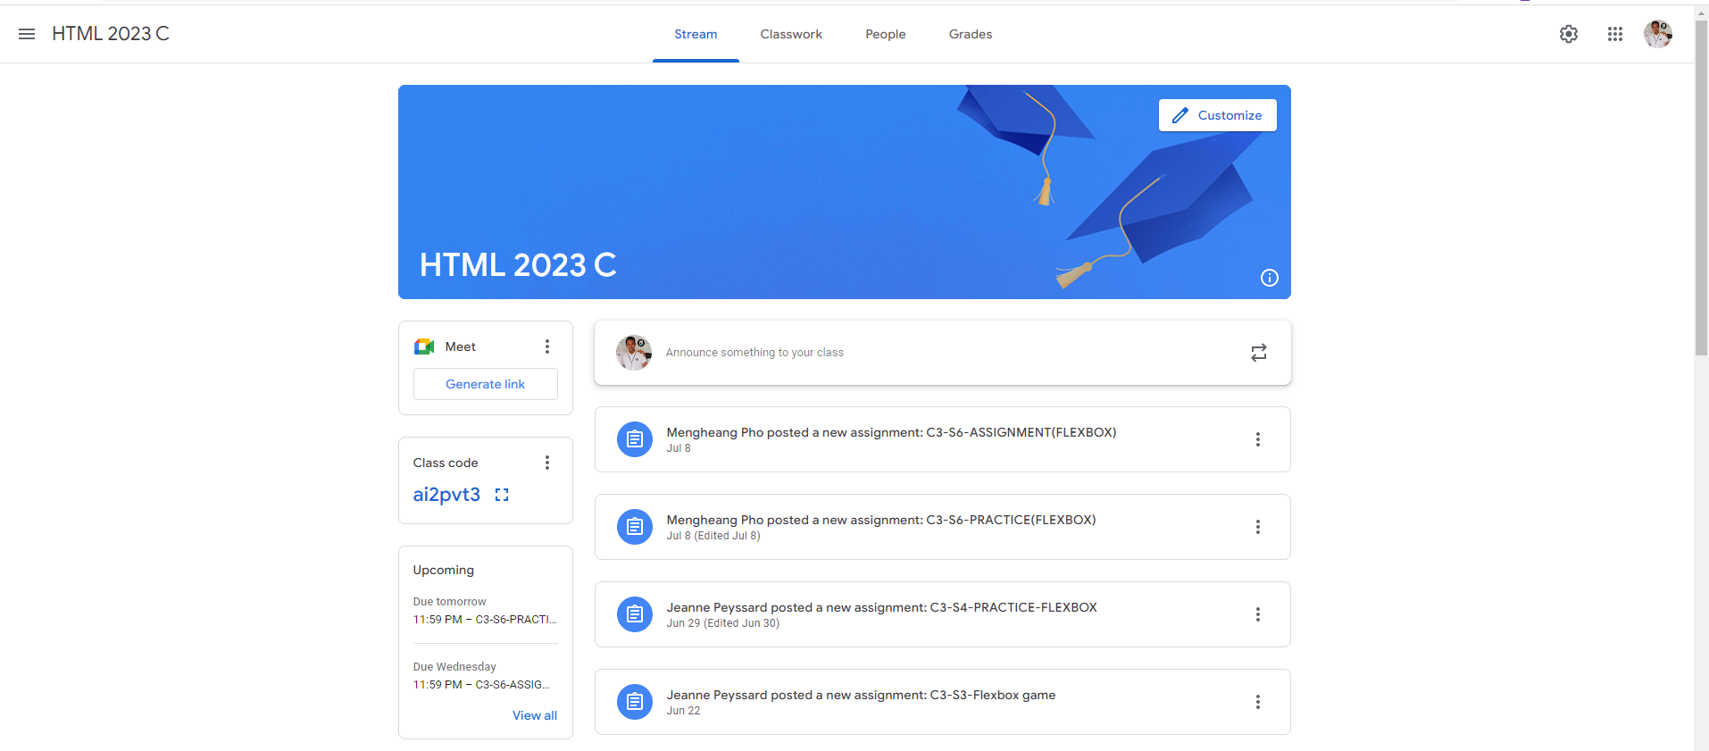
Identify root components of website below

Slide 2
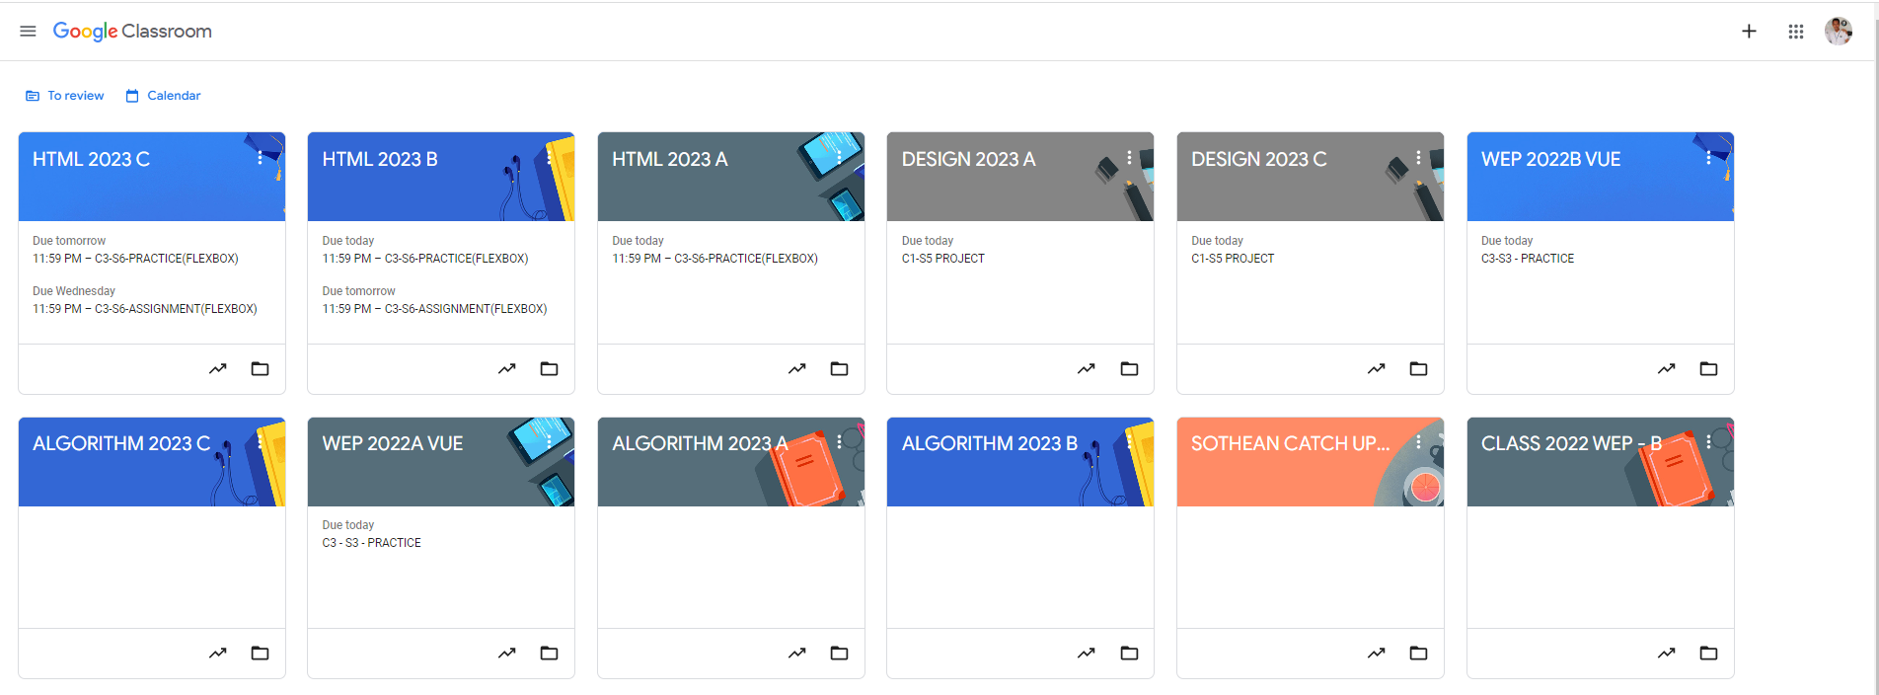
Root div
- Height: 100vh
content
nav
Flex: 0
header
Flex: 0
Flex: 1

Slide 3
Flex: 0
Nav
Main
Flex: 1

Slide 4
Flex:1
Flex:1
Flex:1
Flex-direction: row

Slide 5

flex-direction: column
Flex:0
Header
Flex: 1
Main-section

Slide 6

Flex-direction : row
Section-left
Section-right
Flex: 0
Flex: 1

Slide 7

Flex-direction: column
item1
Flex: 0
item2
Flex: 0
item3
Flex: 1
Section-left

Slide 8

Flex-direction: column
item1
item2
item3
item4
item5
Section-right

